Slide 1

Innovation and flip-learning never stop here at Dawan High School!

Slide 2
Tainan Municipal Dawan High School Story
Taiwan

Slide 3
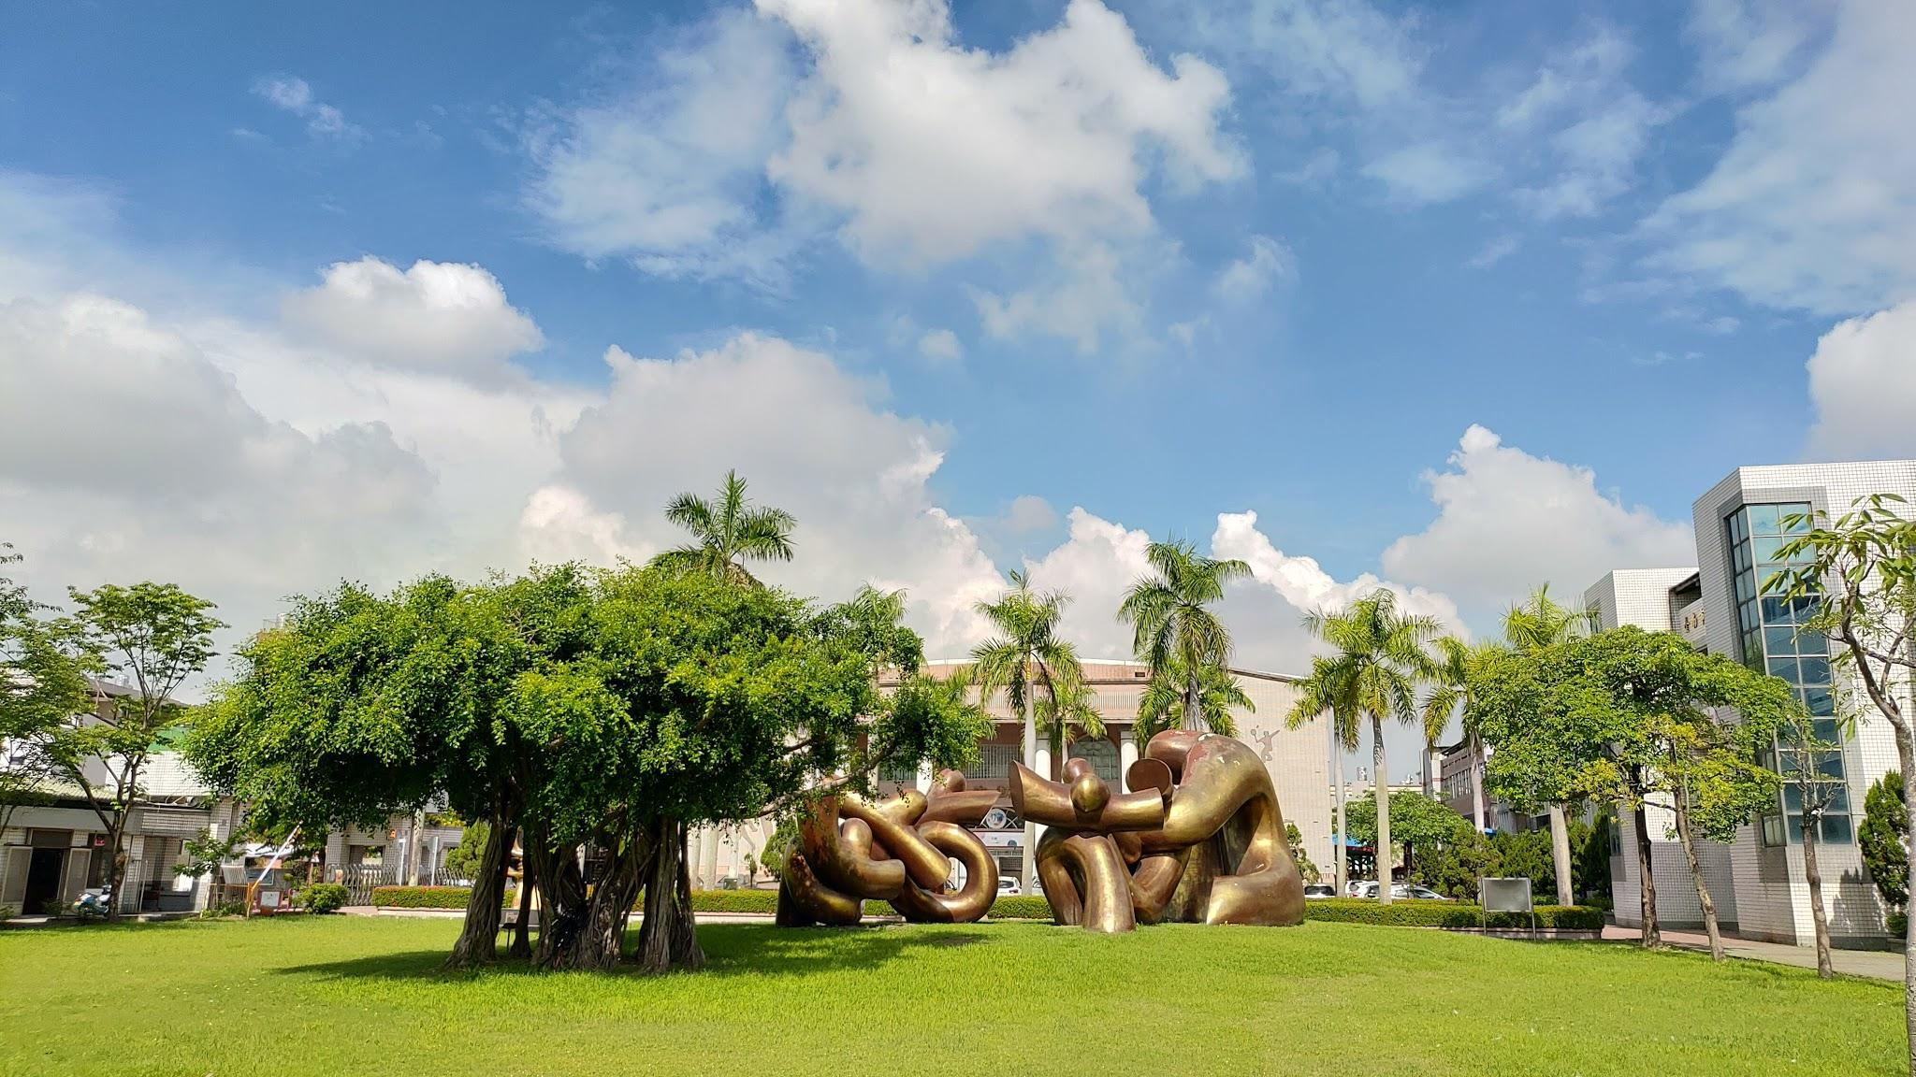


Tainan Municipal Dawan High School

Slide 4

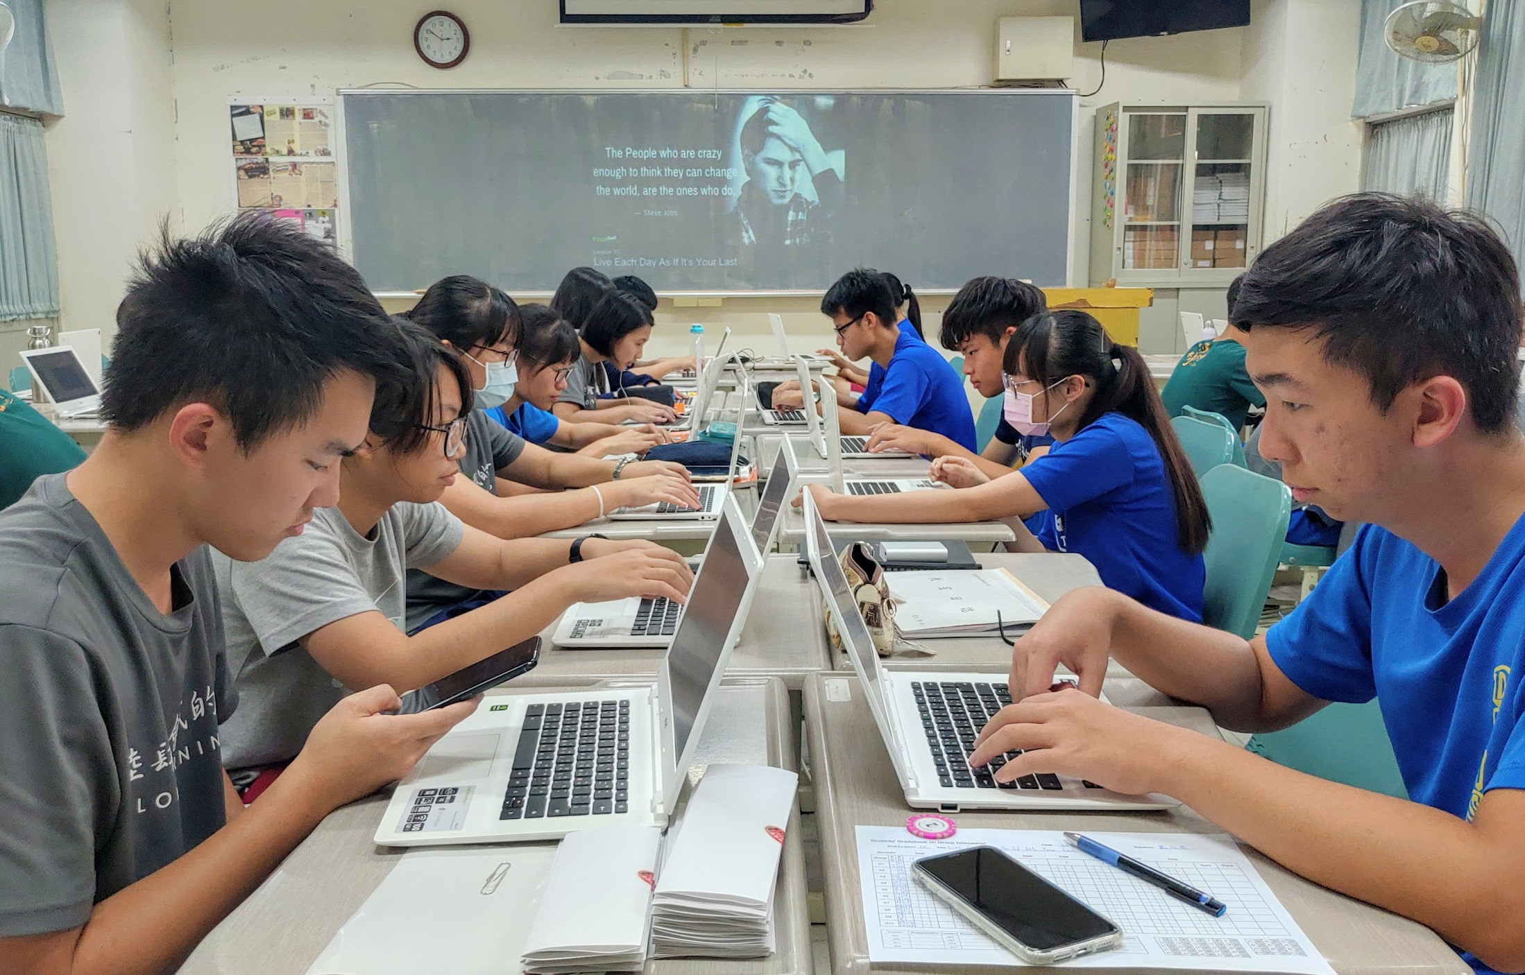
Tainan Municipal Dawan
High School
Increasing student attainment through the use of Google Apps for Education and Chromebooks

Slide 5


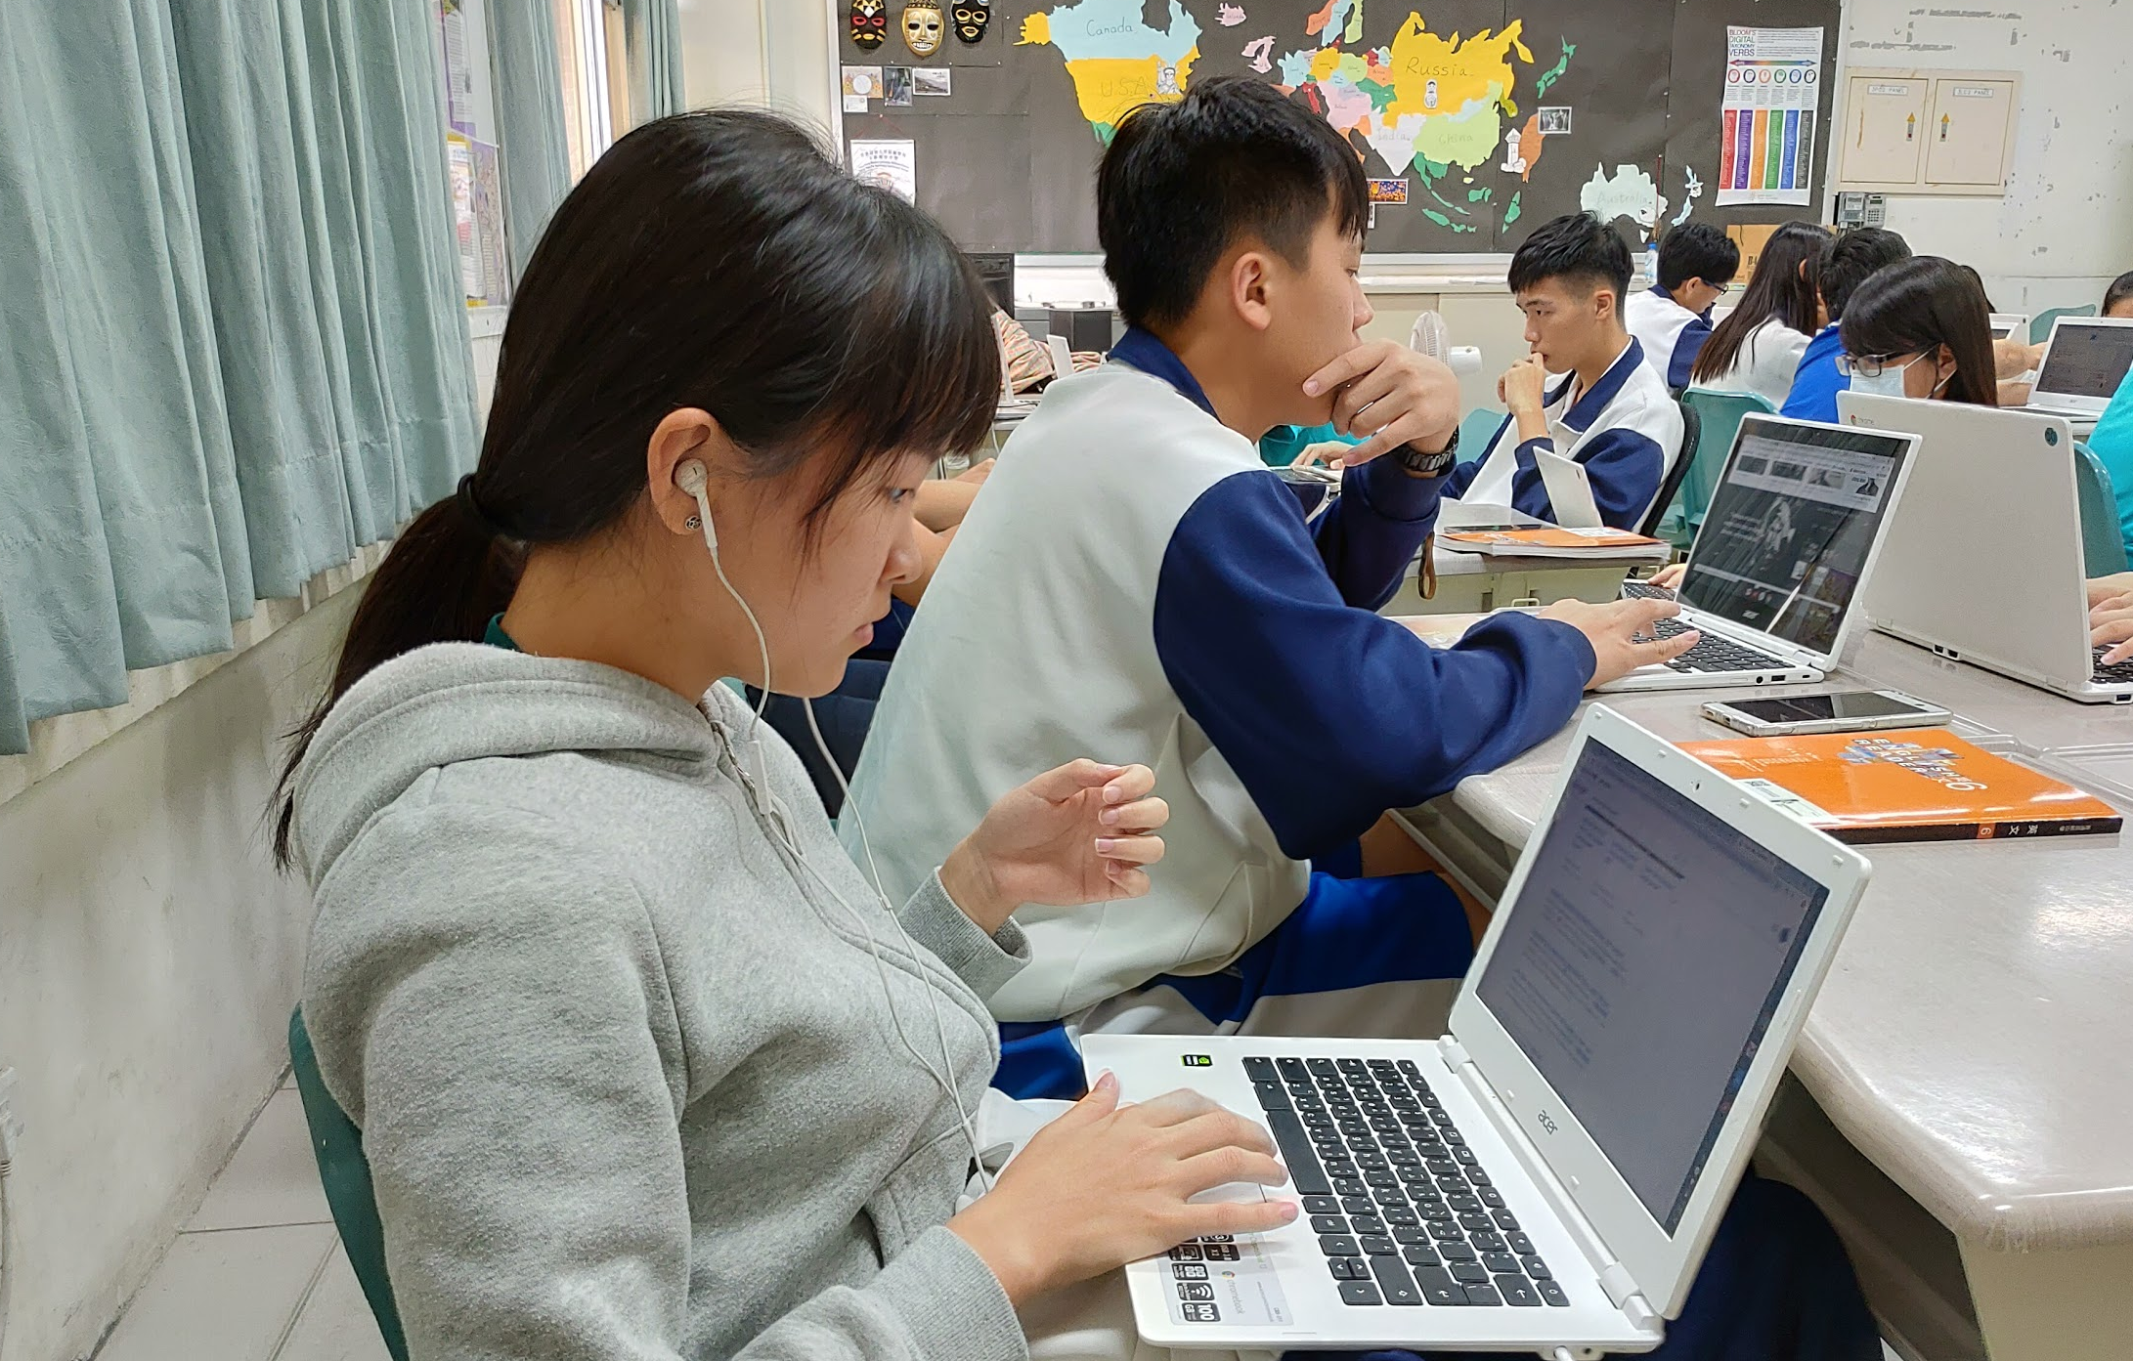
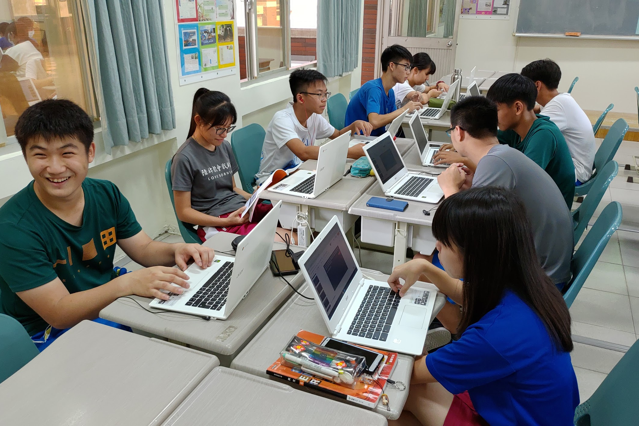
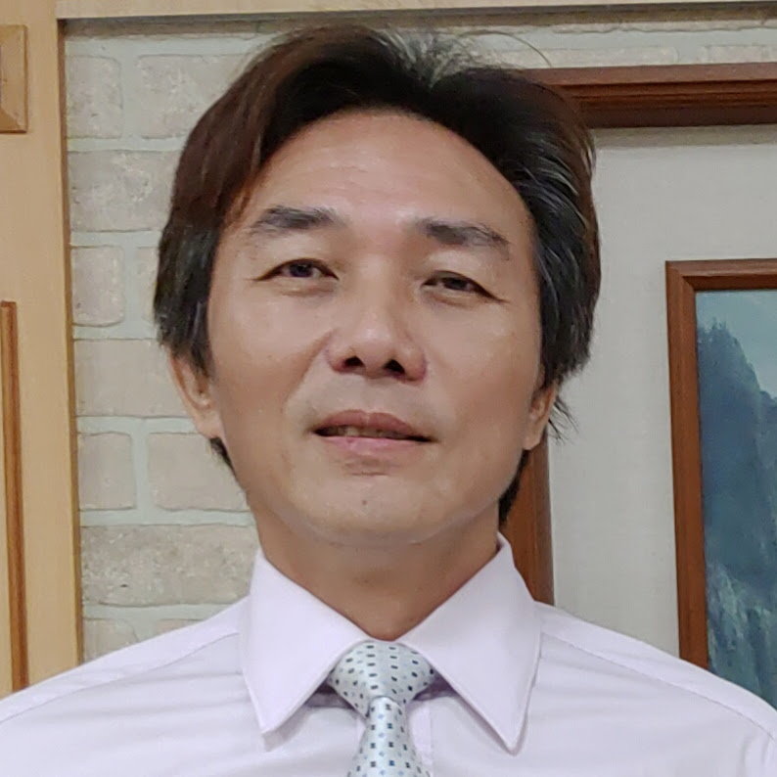
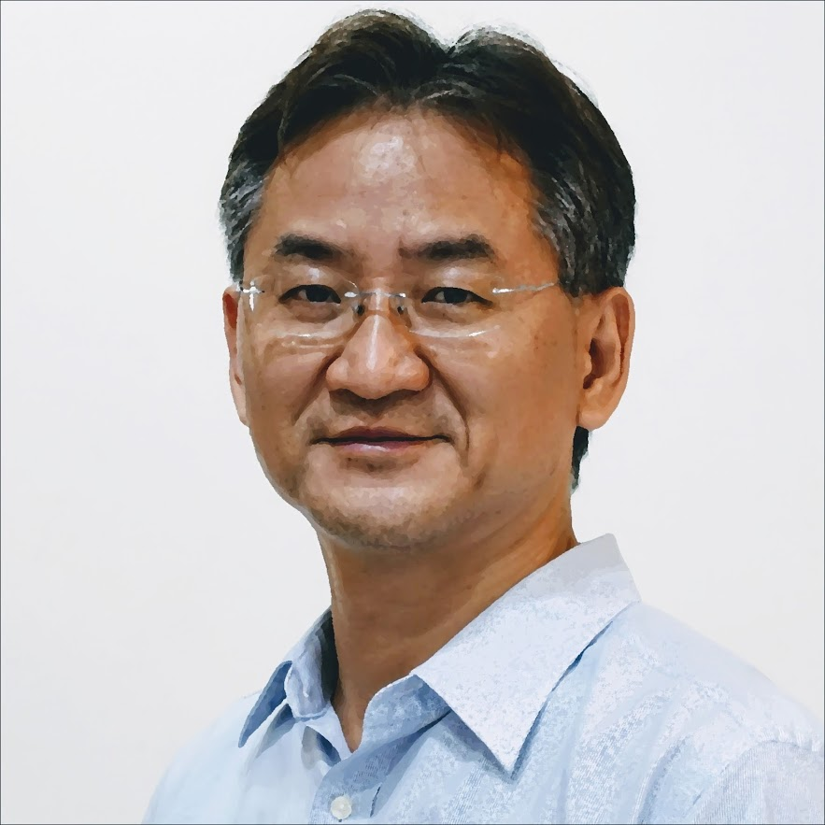
Dawan High School’s Journey
Before Google
With Google
Tainan Municipal High School has been a prestigious school in this city. With the advance of technology and the Internet, the school has been thinking of engaging our students for an even better performance and helping them develop learning skills for their further study in the universities and colleges. The expectation was not really fulfilled until Google G Suite and Chromebooks were implemented in this school.
One Chromebook-based classroom equipped with 50 Chromebooks was set up to serve this purpose in 2015. Students come to this classroom and use their Chromebooks to sign in with their own Google accounts. And this makes all the difference. Two Chromebook Charging carts with 62 Chromebooks can be used to achieve teachers’ teaching goals.
Principal
Li-jiun Yang
Google Certified Trainer
Andy Cheng
Wifi
coverage
99%
“Excellent”
90%
A supportive learning and teaching environment for innovation
A model school for others to follow, willing to share and help
Maths progress rates with Google tools (previously 60-70%)

Slide 6
Adoption Curve
INFLUENCE PEDAGOGICAL CHANGE
Dawan High School’s Google Rollout
EXPAND BASED ON USAGE
START SMALL
Integration of school’s Gmail accounts for all students, teachers and staff brings a solid foundation of innovation for learning and teaching.
Chromebooks have made it possible for the students to learn more efficiently and teachers to teach innovatively. Chromebooks simply lift the school to a higher level.
With successful experience, we are dedicated to sharing and helping other schools to grow with us. We have held workshops, and forums and worked hand in hand with GEG Tainan.
Notes:
START SMALL: Teachers weren’t forced to use Google tools in every lesson right away. They started using their Chromebooks just 15 minutes each morning.
EXPAND BASED ON USAGE: Year 4 teachers use Google Docs for writing activities and they’ve seen an increase in engagement and overall marks as a result. Year 6 teachers found new maths apps to use on the devices to create more opportunity for personalised learning.
INFLUENCE PEDAGOGICAL USE:

Slide 7
Key Factors for Success
100% Supportive Administration
Solid and Reliable Learning Tools - Chromebooks & G Suite
No innovation in schools is possible without the administrative support. The administrative is the strongest backup for our success. Our students have learned better and become more engaged since then.
Chromebooks give all students the opportunity to work with each other as groups collaboratively at real time or off-line. All the docs, slides and sheets can be saved without any problem in Google Drive, which makes, which has made learning more productive and accumulative.
Key Factors for Success
Sharing and Devotion
Devoted Teachers and Active Students
Successful learning takes devoted teachers and active students. With Google G Suite for education things become much easier and more effective. It all pays off when seeing all the students and teachers become so engaged.
Sharing with other schools is what keeps us growing and becoming more devoted. Working with GEGs also helps us look forward to an even better future.

Slide 8

It takes enthusiastic teachers and passionate students to make things work. However, it reaches the highest potentials for all with Chromebooks and G Suite for Education from Google.
Teaching and learning never stop here!
Andy Cheng, Teacher
Tainan Municipal Dawan High School
Notes:
Technology:
Reliability of the solution (down time for individual students)
Integration of Google tools/devices within current technology setup
Ease of use of the Management Console and tools

Slide 9
The Google for Education team is keen to hear your stories!
Please share them back with us using this form.

